Slide 1


Department of Computer Science and Engineering
HEART DISEASE PREDICTOR INCORPORATING LIFESTYLE FACTORS
Mrs.Divya M,
Department of CSE
Rajalakshmi
Engineering College
Chennai, India
2116220701243
SANCHITHA GR

Slide 2
Problem Statement and Motivation
Problem Statement Heart disease is a leading cause of death globally, but many people
don’t know they’re at risk until it’s too late. Existing tools often ignore lifestyle factors like
smoking or exercise, and don’t provide clear prevention advice.
There’s a need for a simple, accurate tool that predicts heart disease risk based on everyday habits.
Motivation This project aims to prevent heart disease by using machine learning and
lifestyle data to predict risk early. The goal is to create a user-friendly system
that not only predicts risk but also provides visual scores and personalized tips,
encouraging healthier choices and prevention.

Slide 3
Existing System
Current heart disease prediction tools mostly rely on clinical data like blood tests and medical history. They are often used by doctors and are not easily accessible to the general public. Some online calculators exist, but they usually give basic results without considering lifestyle habits such as smoking, diet, or physical activity. These systems also lack personalized advice, visual feedback, and user engagement features, making it hard for users to take meaningful action.

Slide 4
Objectives
This project aims to create a simple web app that helps people check their risk
of heart disease based on their daily habits, like how much they smoke or ride a bike.
When someone enters their information, the app uses a smart model to predict their risk as a percentage and shows whether it’s low, moderate, or high. It also gives easy-to-follow health tips, such as quitting smoking or exercising more, to help lower the risk. The goal is to make it easier for people to understand their heart health and take steps to stay healthy.

Slide 5
Abstract
Most existing heart disease prediction tools are designed for clinical use and depend heavily on medical data such as blood pressure, cholesterol levels, or ECG results. These tools are often not user-friendly or accessible to the general public. While some online risk calculators are available, they typically provide only basic results without considering important lifestyle habits like smoking, physical activity, diet, or stress levels. They also lack features like visual risk scores or personalized health tips, which are key to user engagement and action. As a result, people may not fully understand their risk or know how to reduce it through lifestyle changes.

Slide 6
Proposed System
The proposed system is a user-friendly web application that uses machine learning to predict heart disease risk based on lifestyle factors such as smoking, exercise, diet, and stress. It provides clear visual risk scores and personalized health tips to help users understand and lower their risk. By focusing on everyday habits, the system encourages early prevention and empowers users to make healthier choices.

Slide 7
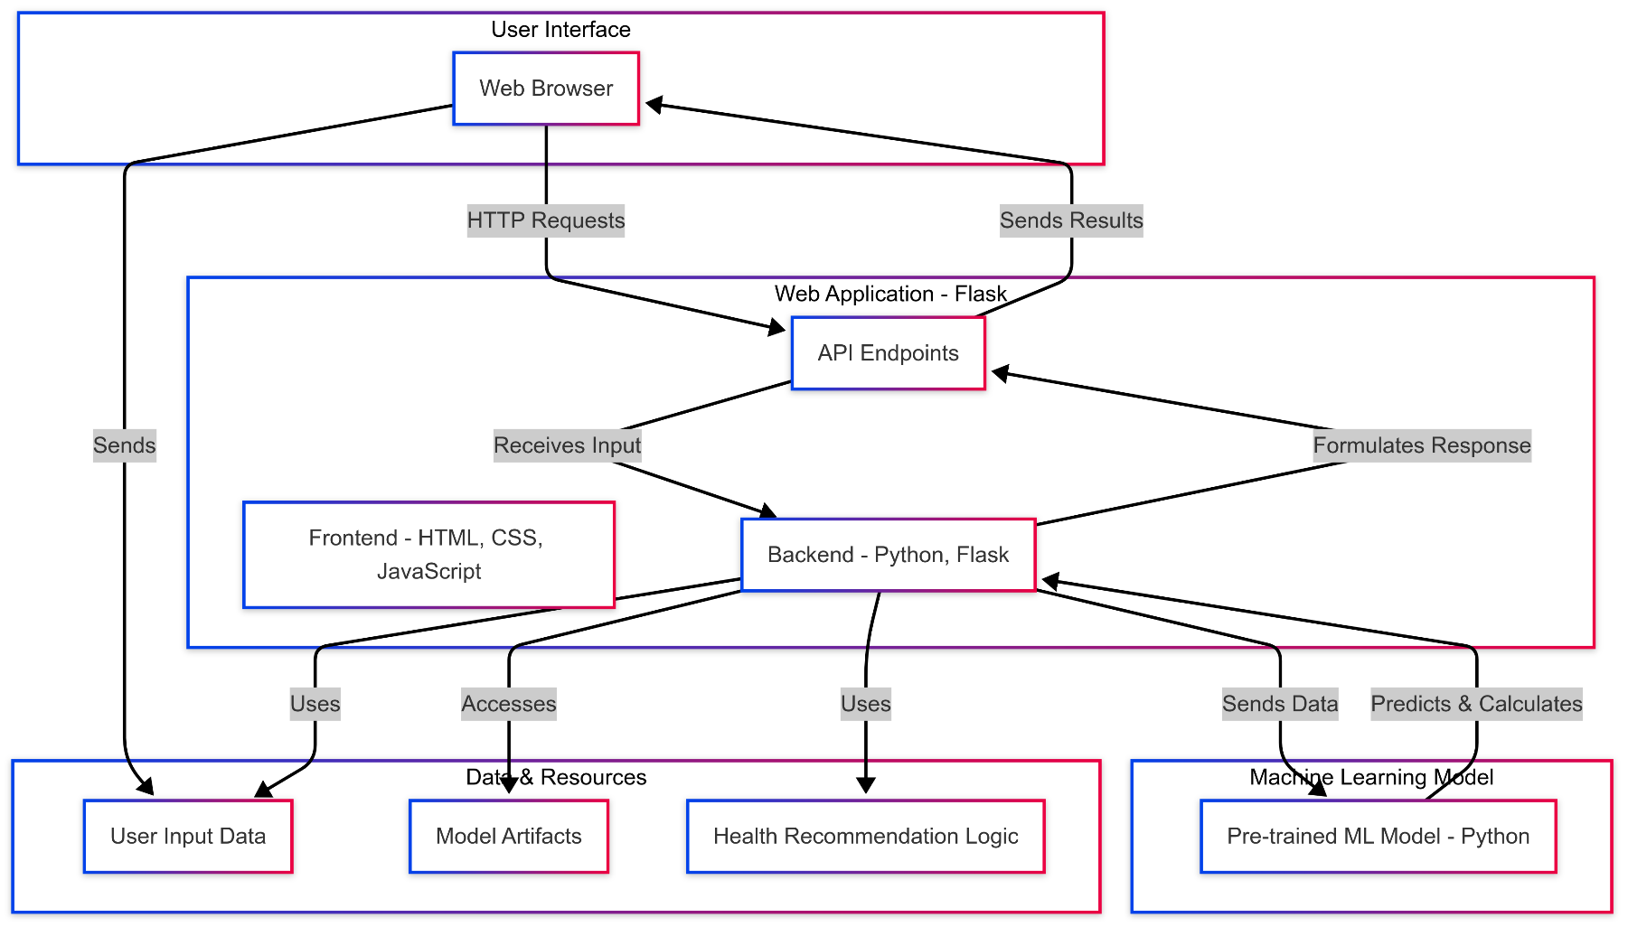
System Architecture

Slide 8
List of Modules
1. Data Collection Module Collects user inputs related to lifestyle factors (e.g., smoking, physical activity, diet, stress).
2. Prediction Module Uses a trained machine learning model to predict heart disease risk based on the input data.
3. Recommendation Module Provides personalized health tips and suggestions based on the user’s lifestyle and risk level.
4. User Interface Module Handles user interaction through a simple and accessible web interface (built using Flask/HTML/CSS).

Slide 9
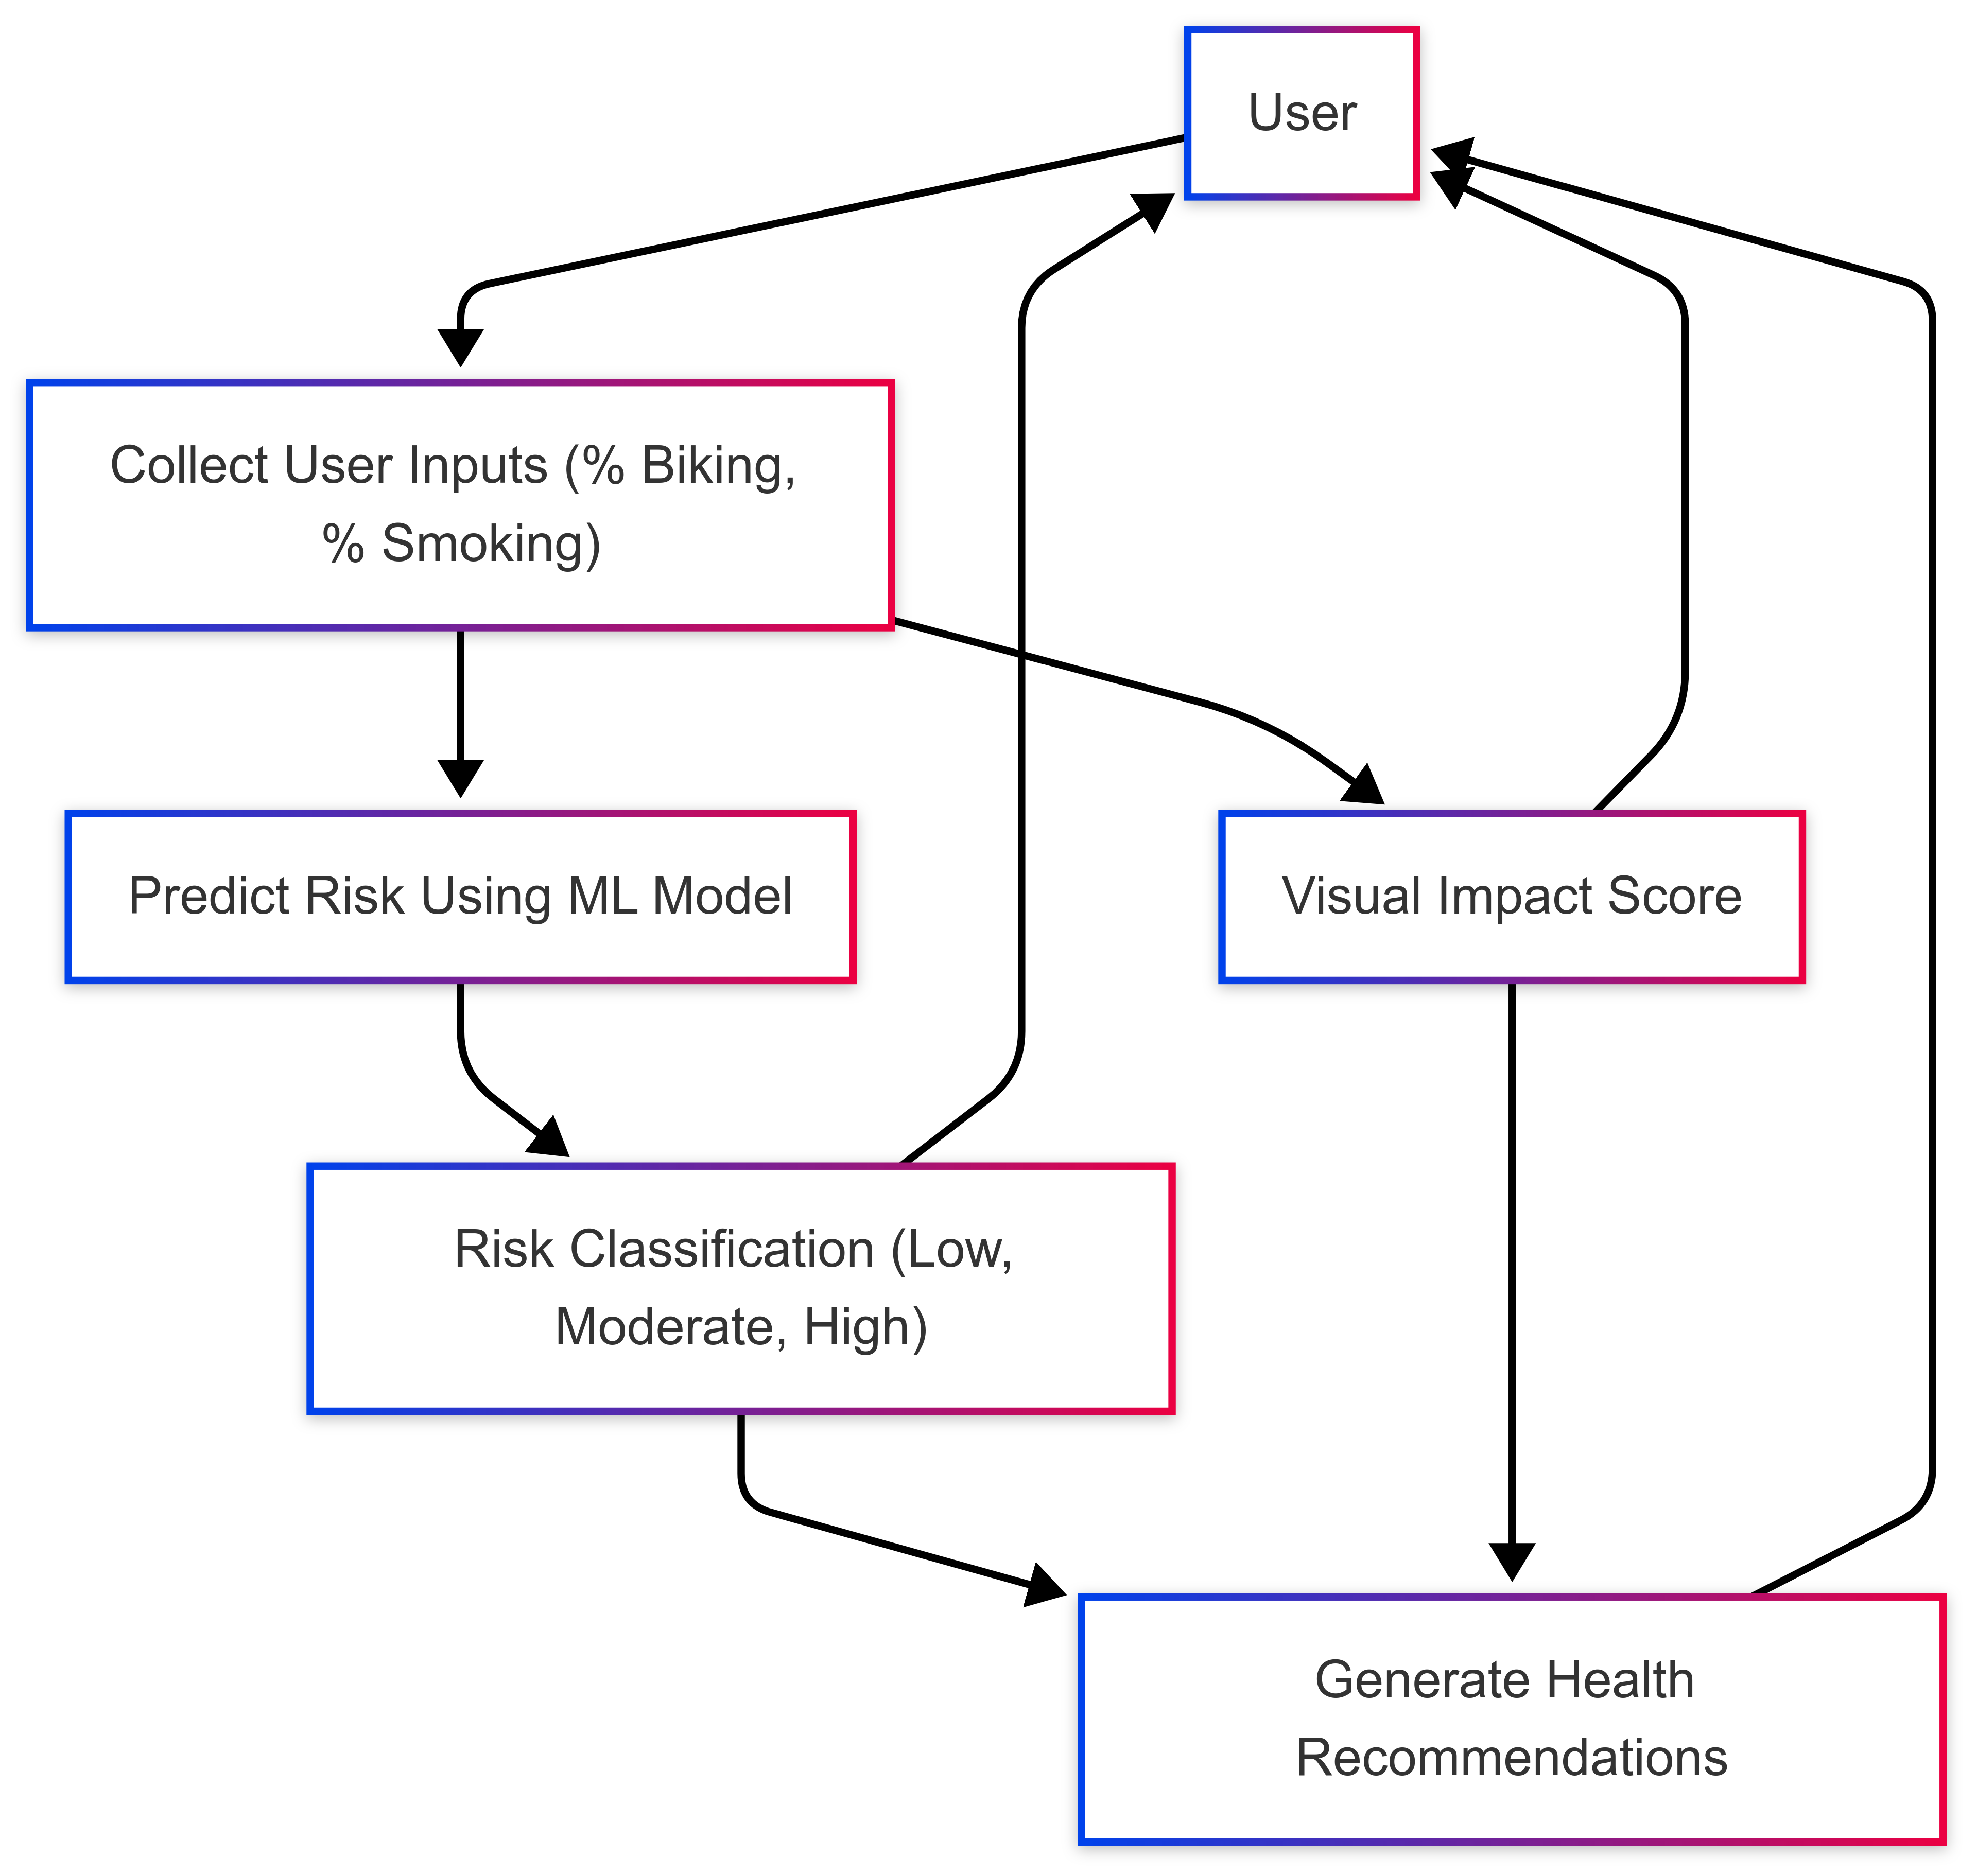
Functional Description for each modules with DFD and Activity Diagram

Slide 10
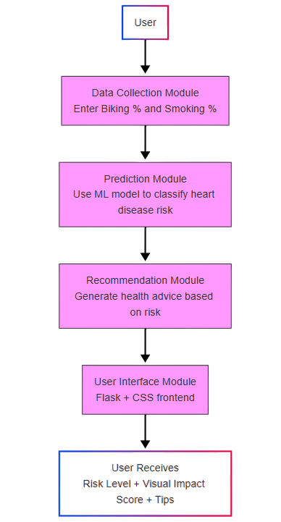
Activity Diagram

Slide 11
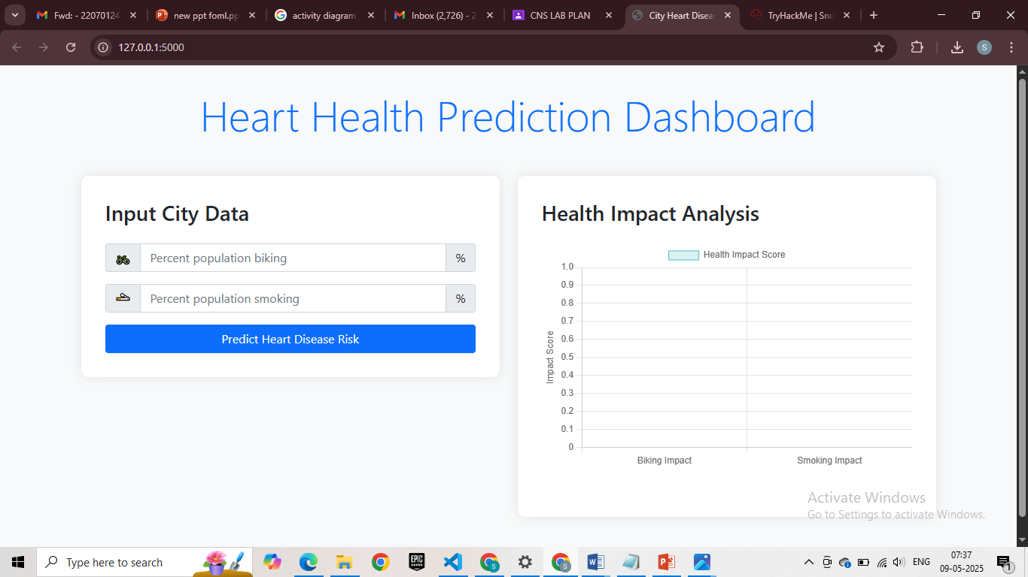
Implementation & Results of Module

Slide 12
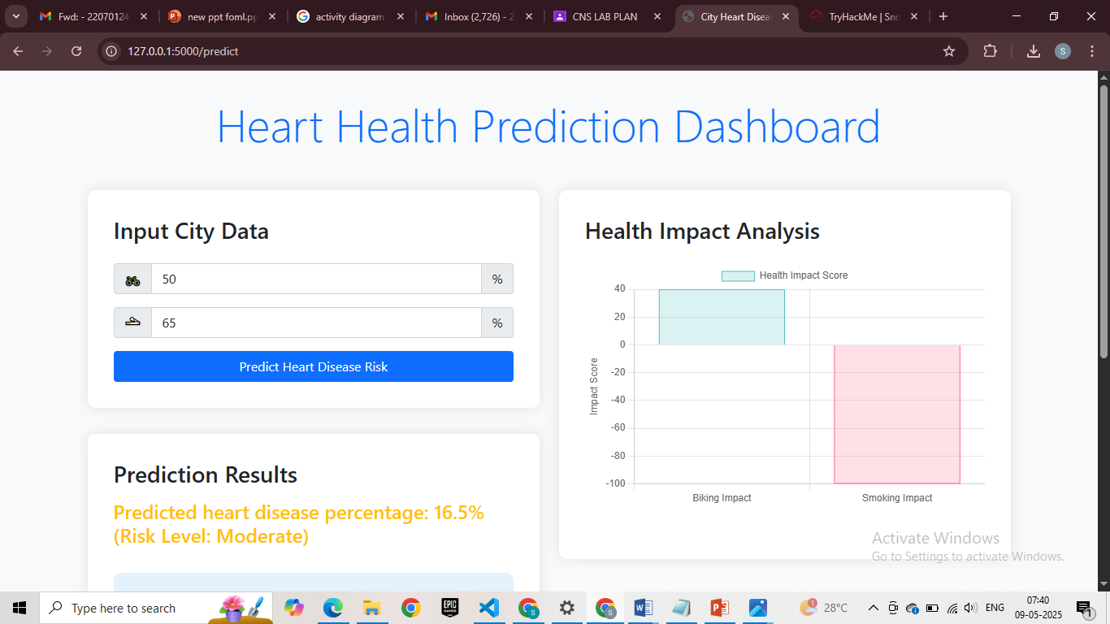
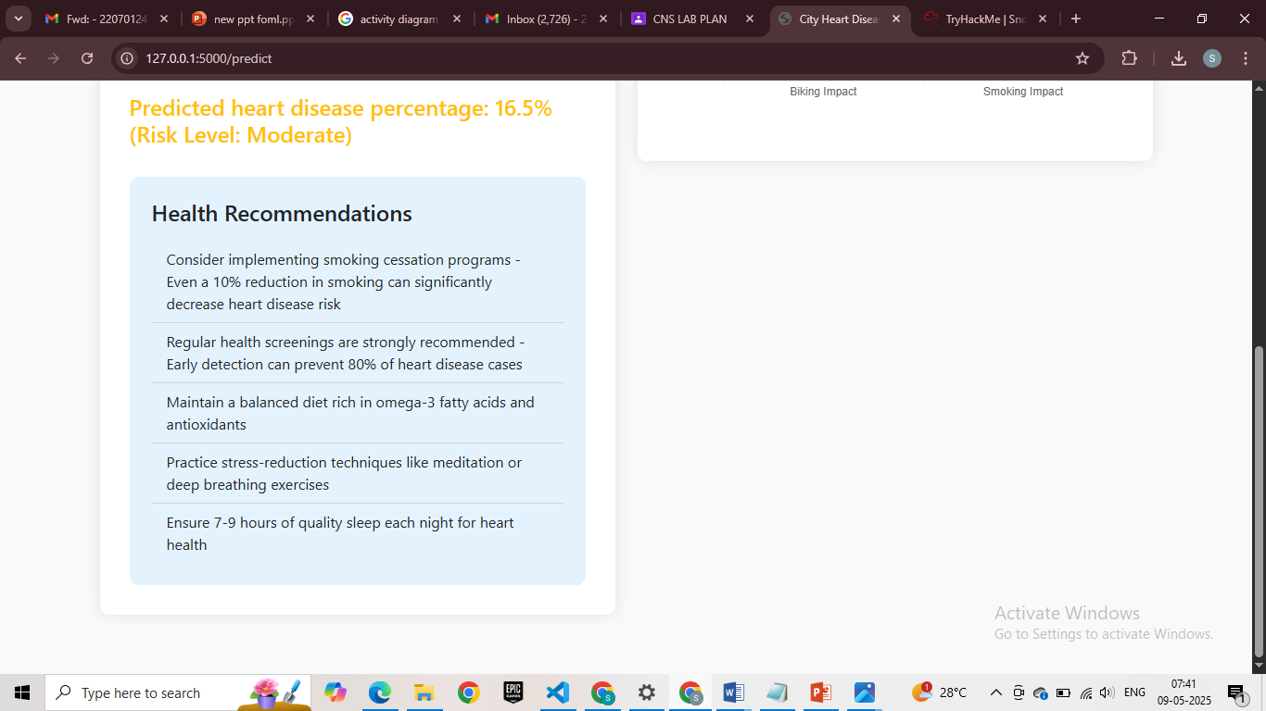
Implementation & Results of Module

Slide 13
Conclusion & Future Work
This project uses machine learning to help people find out if they are at risk of heart disease based on their daily habits like smoking and exercise. It gives each person a risk score along with helpful charts and advice on how to live healthier. The goal is to prevent heart disease before it starts, by encouraging early lifestyle changes. While the system is useful, its accuracy depends on good input data and could be improved with more health factors and real-time data from fitness devices. In the future, it can be made better and used in clinics or apps to help more people stay heart-healthy.

Slide 14
References
https://www.who.int/news-room/fact-sheets/detail/cardiovascular-diseases-(cvds)
https://www.cdc.gov/heartdisease/prevention.htm
https://www.nhlbi.nih.gov/health-topics/risk-assessment
https://www.sciencedirect.com/science/article/pii/S2352914821000143
https://ieeexplore.ieee.org/document/9153910

Slide 15
Thank You

